Slide 1



Solano College Athletics
HALL OF FAME
2026

Slide 2
INTRODUCING YOUR MC
MATT BORCHERT
2026
HALL OF FAME
Solano College Athletics

Slide 3
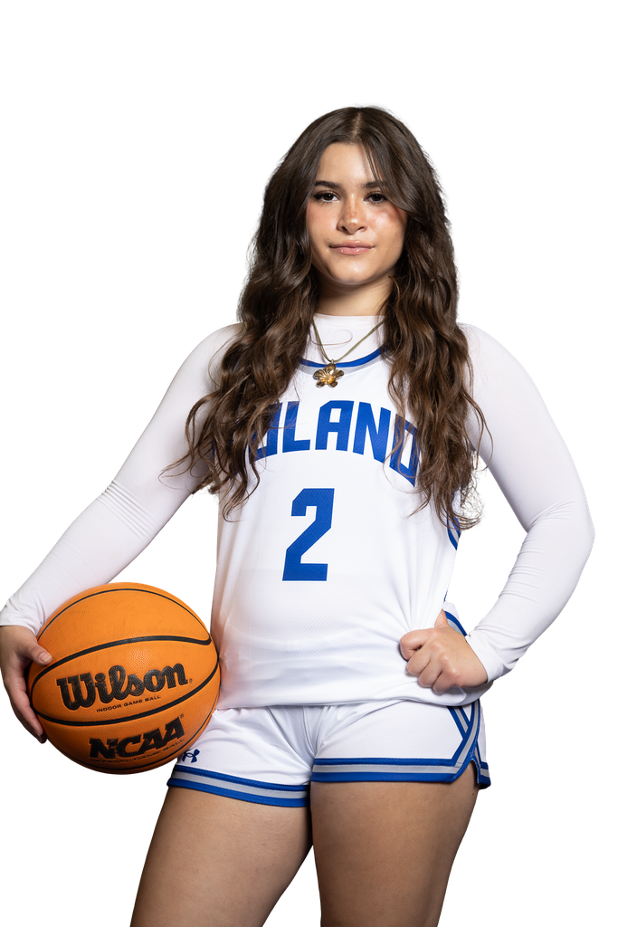
LAND ACKNOWLEDGEMENT
HILLARY STEINMAN
2026
HALL OF FAME
Solano College Athletics

Slide 4
WELCOME
ATHLETIC DIRECTOR
KAREN YODER
2026
HALL OF FAME
Solano College Athletics

Slide 5

ASSISTANT ATHLETIC DIRECTOR
ALISON AUBERT
BRANDING
PROJECT
COMMISSIONER’S CUP
AD TEAM AWARD
LINK
2026
HALL OF FAME
Solano College Athletics

Slide 6

Solano College Athletics
2026
HALL OF FAME CLASS
KYLE BIBLE - BASEBALL (2008-2009)
KATIE KNOPP - SOCCER (2006-2008)
JENNIFER MCCRUM - SOFTBALL (2010-2011)
LAURA LAWSON - WOMEN’S BASKETBALL (2013-2015)
LAINEY BROWN - VOLLEYBALL (2011-2013)
ARIEL CLAY - WOMEN’S BASKETBALL (2012-2014)
ERIK VISSER - ATHLETIC DIRECTOR (2014-2025)

Slide 7
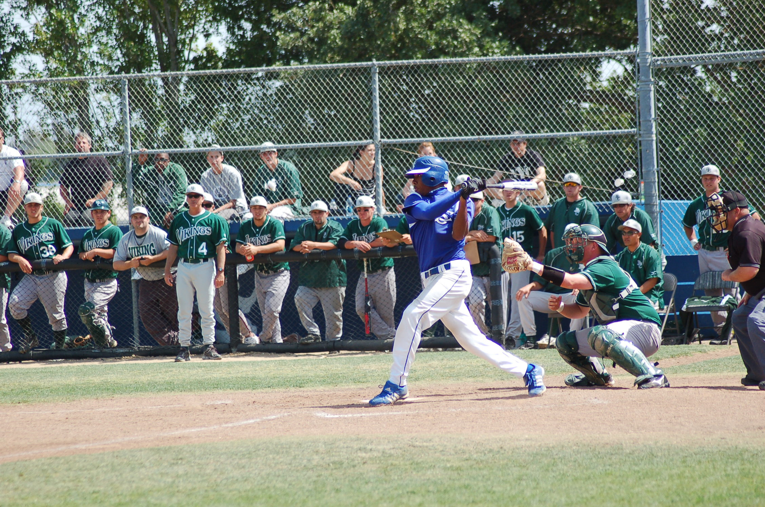
Solano College Athletics
2026
HALL OF FAME CLASS
KYLE BIBLE
BASEBALL (2008-2009)

Slide 8
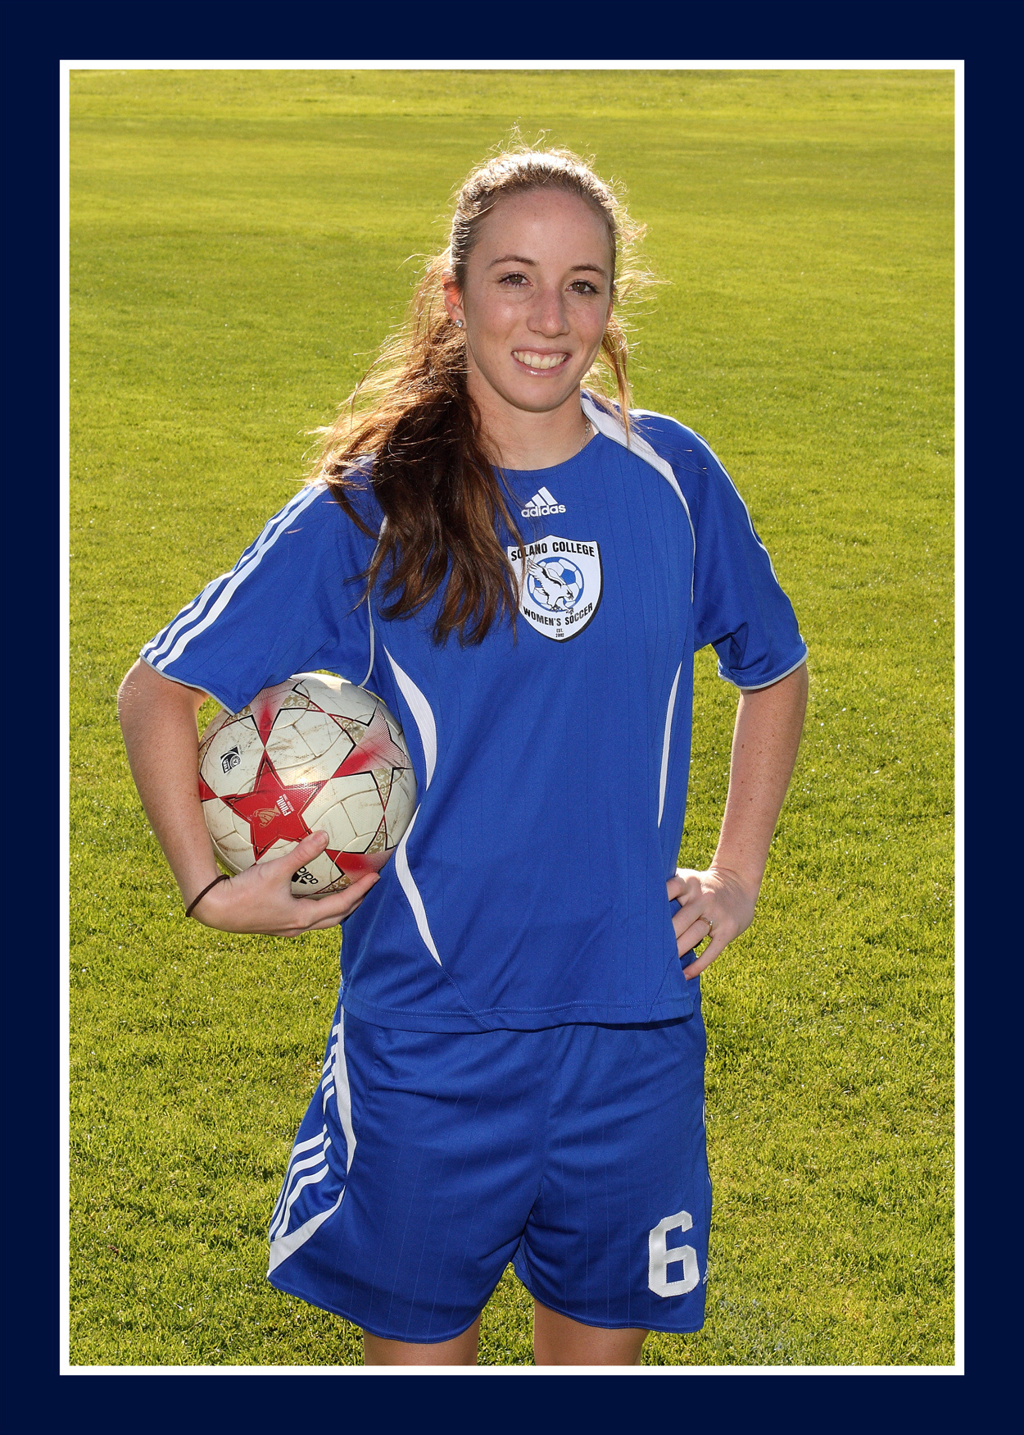
Solano College Athletics
2026
HALL OF FAME CLASS
KATIE KNOPP
SOCCER (2006-2008)

Slide 9
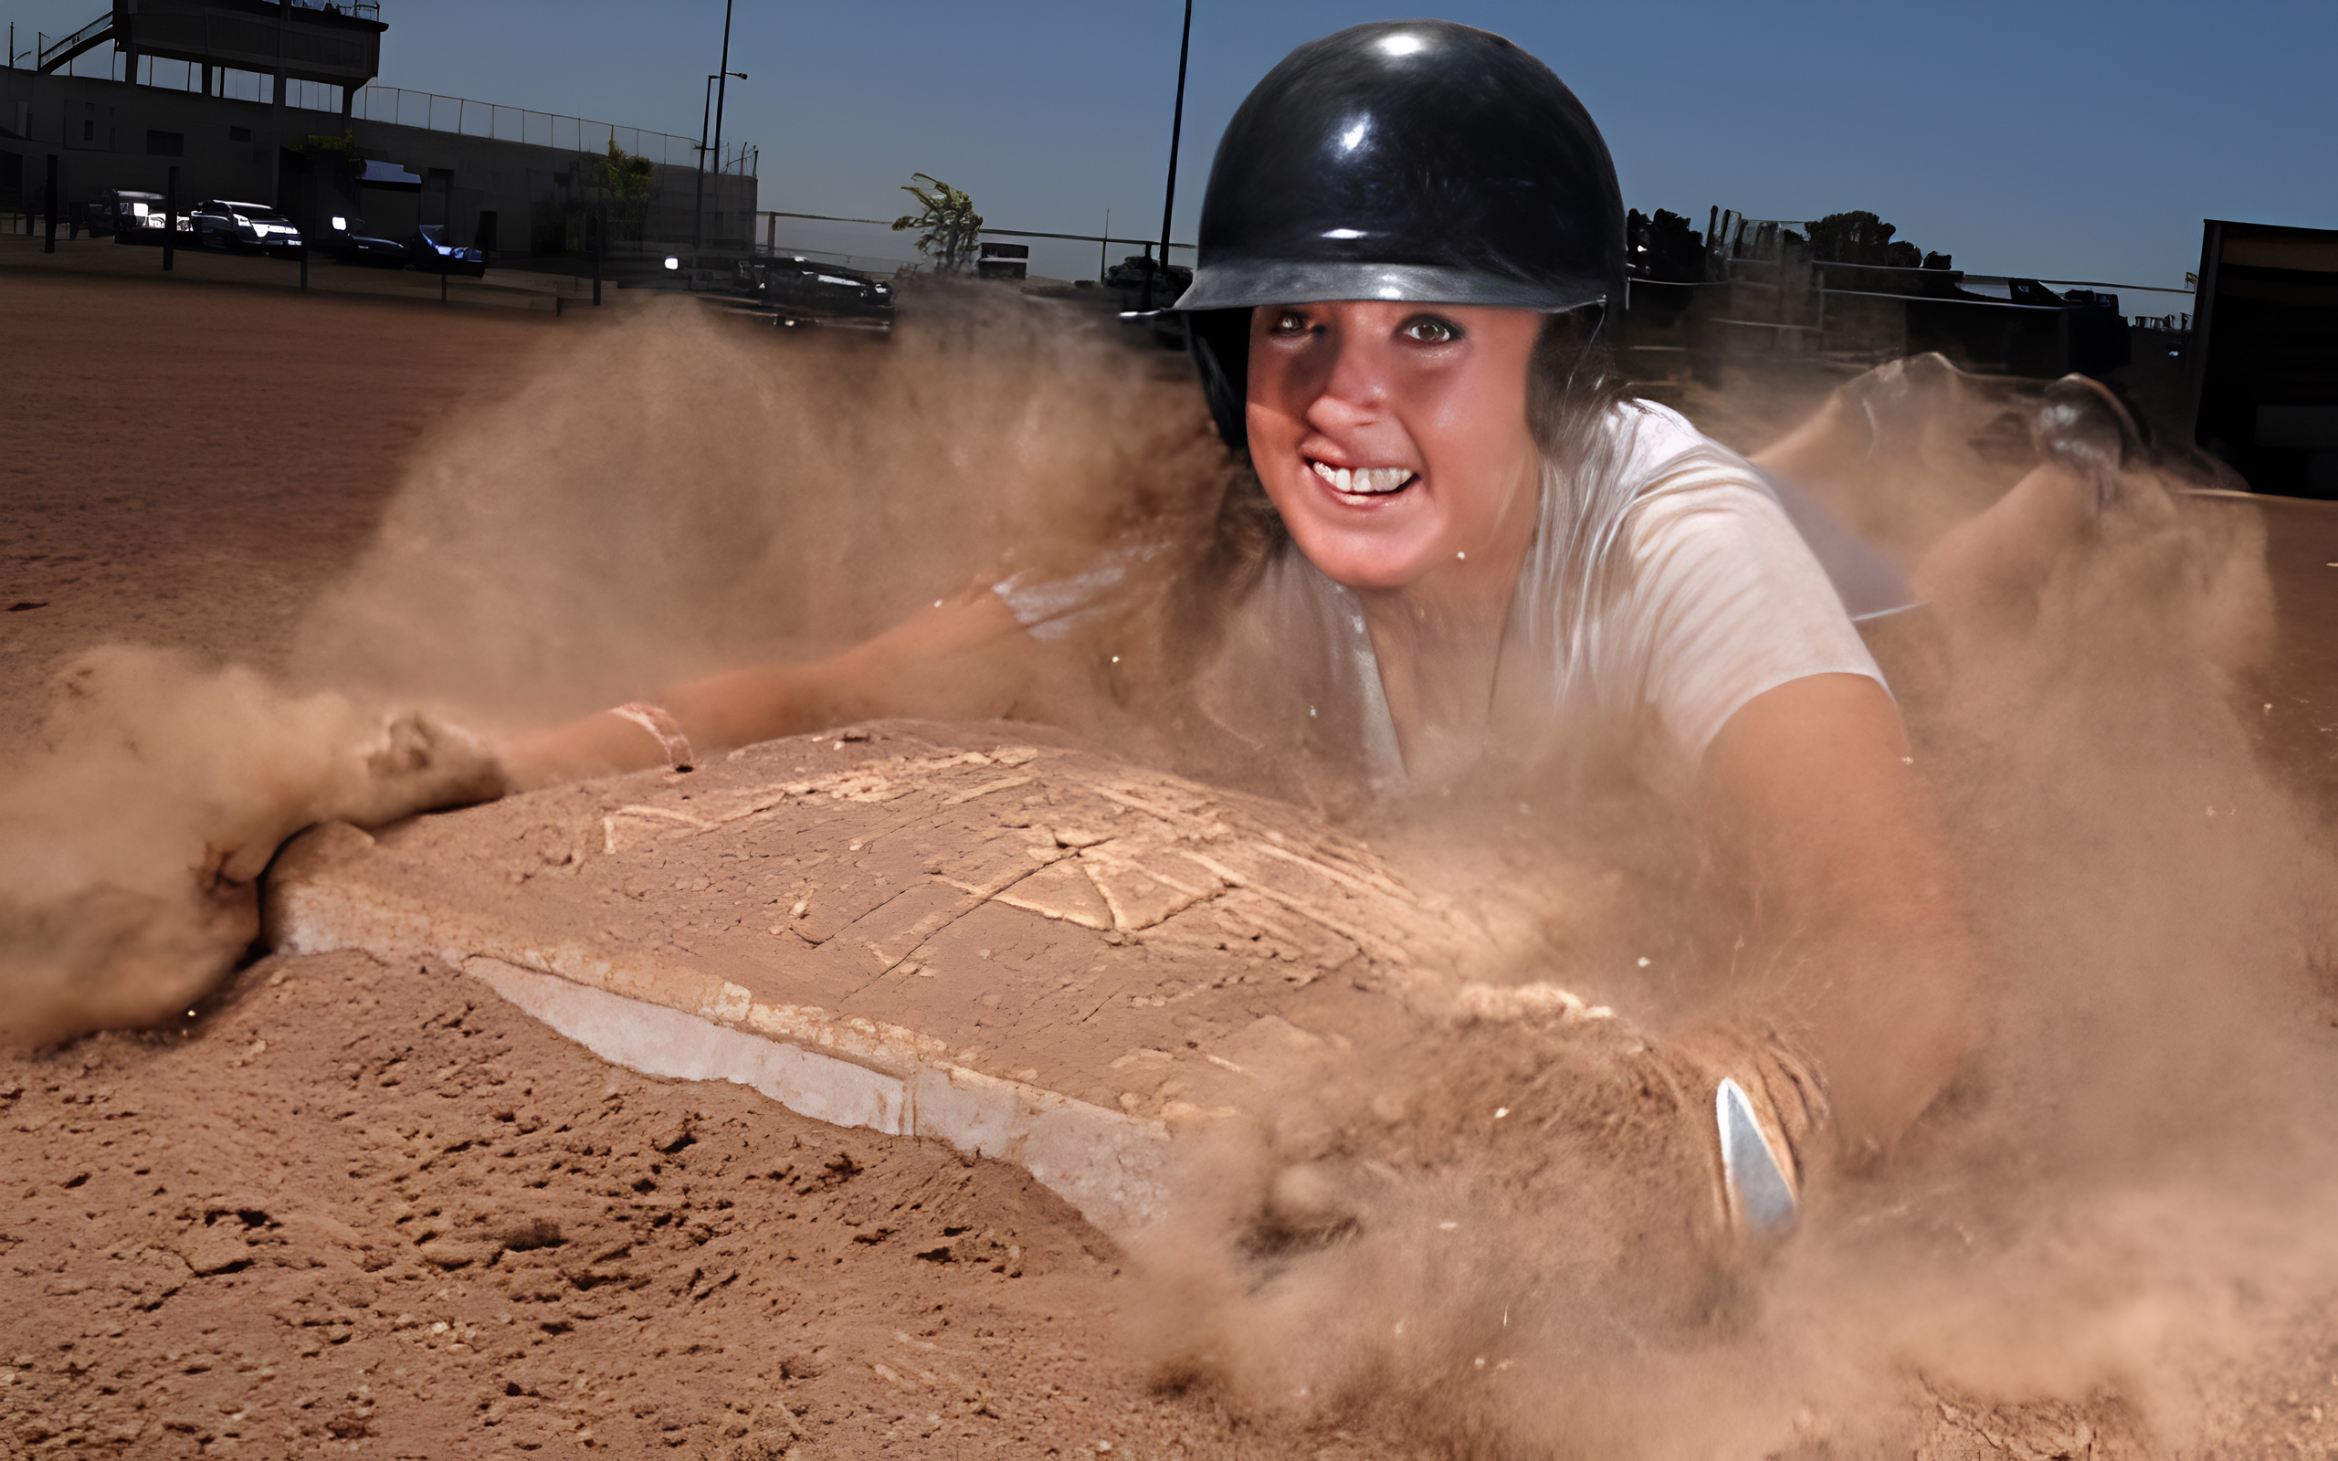
Solano College Athletics
2026
HALL OF FAME CLASS
JENNIFER MCCRUM
SOFTBALL (2010-2011)

Slide 10
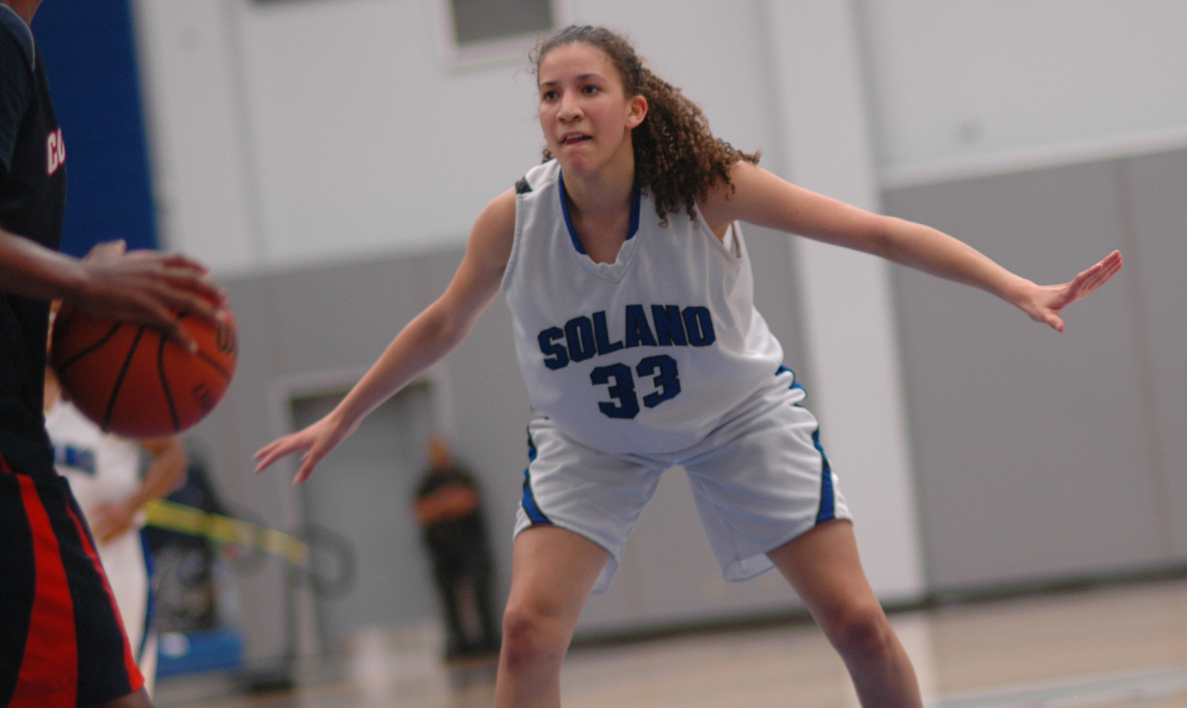
LAURA LAWSON
WOMEN’S BASKETBALL (2013-2015)
Solano College Athletics
2026
HALL OF FAME CLASS

Slide 11
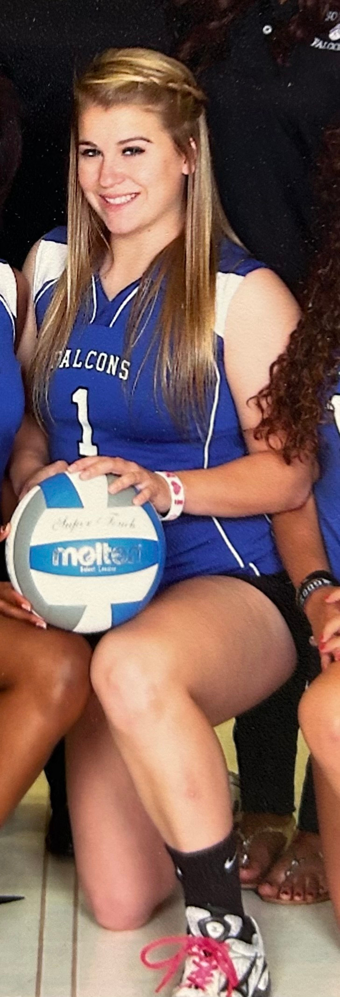
Solano College Athletics
2026
HALL OF FAME CLASS
LAINEY BROWN
VOLLEYBALL (2011-2013)

Slide 12
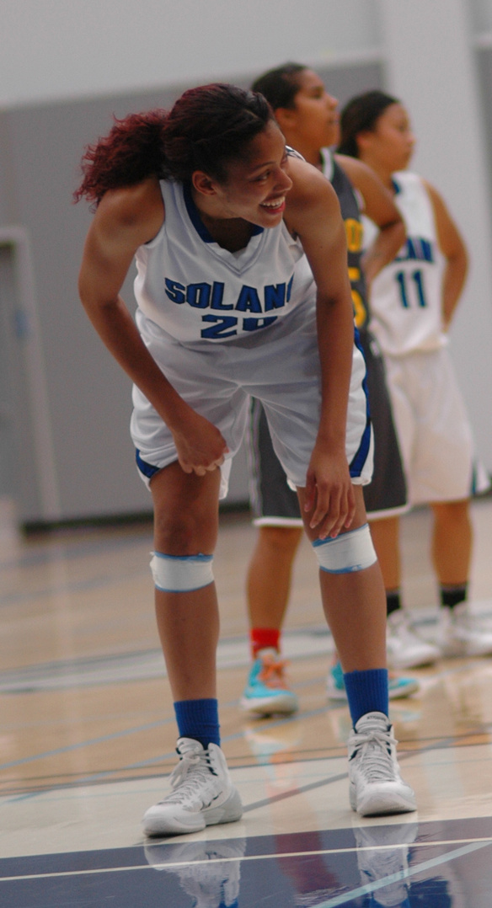
Solano College Athletics
2026
HALL OF FAME CLASS
ARIEL CLAY
WOMEN’S BASKETBALL (2012-2014)

Slide 13
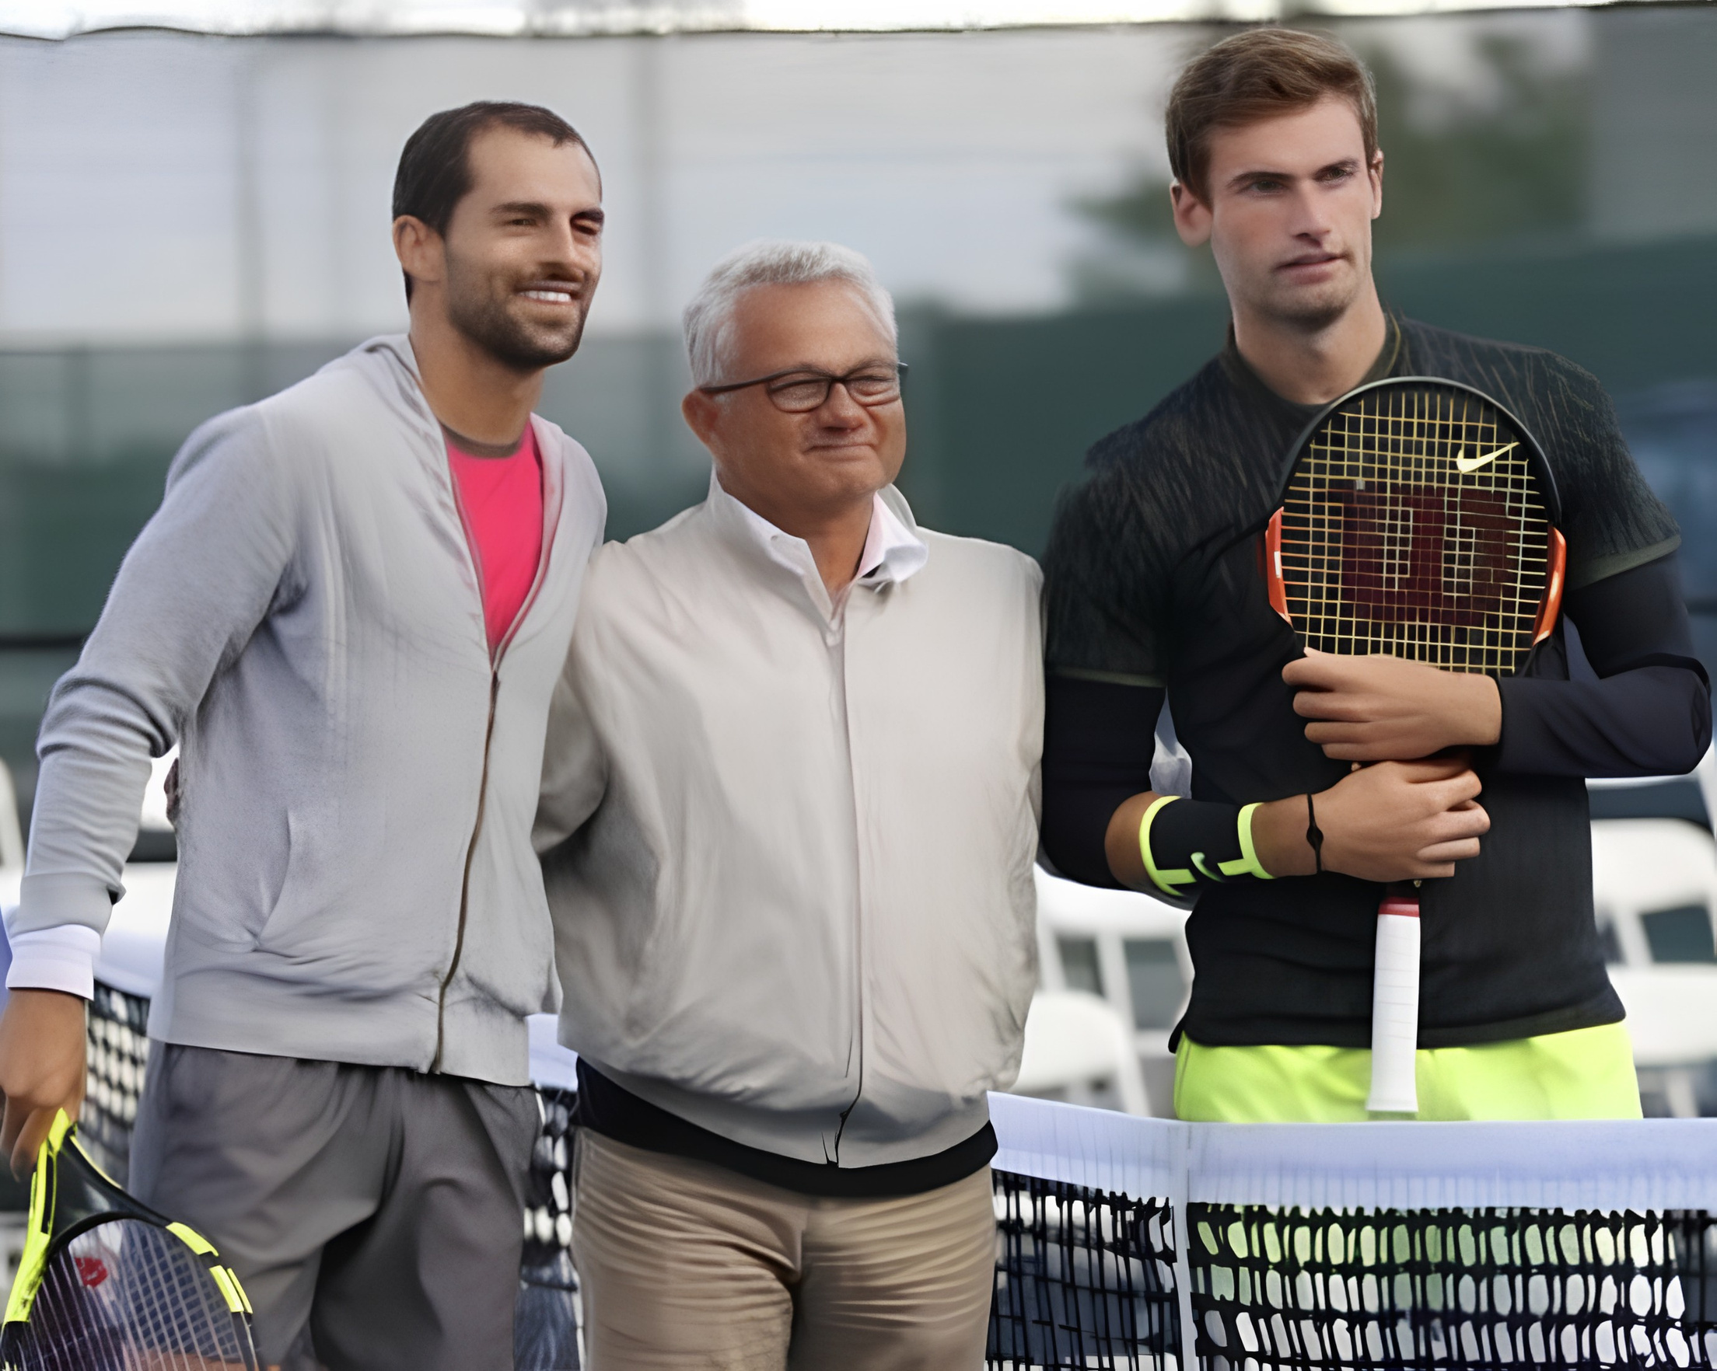
Solano College Athletics
2026
HALL OF FAME CLASS
ERIK VISSER
ATHLETIC DIRECTOR (2014-2025)

Slide 14
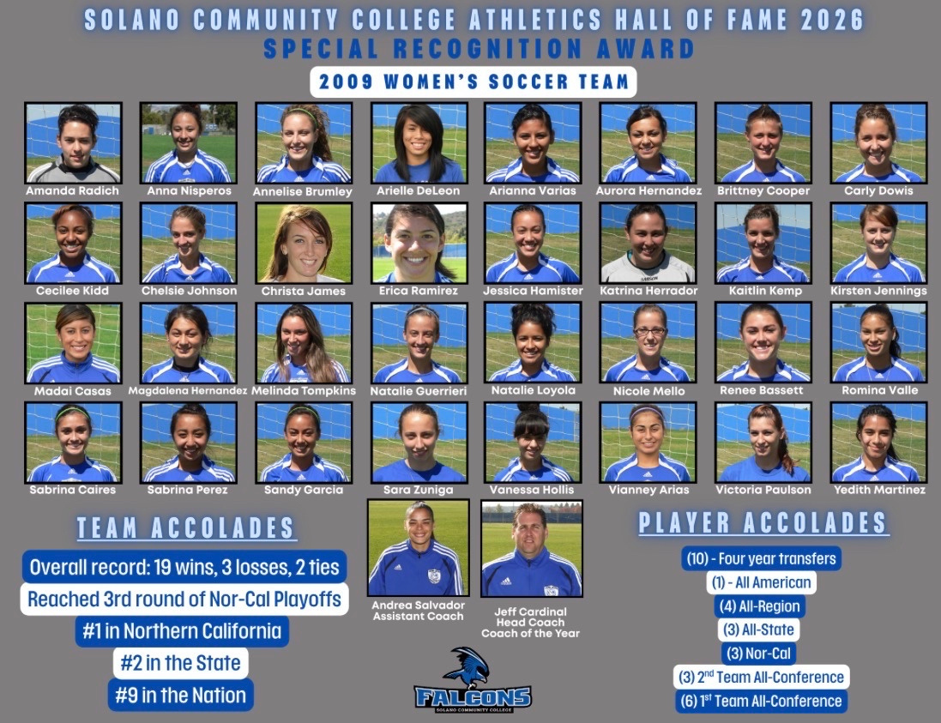
Solano College Athletics
2026
TEAM SPECIAL RECOGNITION
WOMEN’S SOCCER TEAM
2009

Slide 15
Solano College Athletics
2026
TEAM SPECIAL RECOGNITION
WOMEN’S SOCCER TEAM
2009
Overall Record
19 - 3 - 2
Player Achievements
1 All American
4 All-Regions
3 All-State Players
3 Nor-Cals
3 2nd Team All-Conference Players
6 1st Team All-Conference Players
10 players moved on to the next level
Rankings
#1 in Northern California
#2 in the State
#9 in the Nation

Slide 16
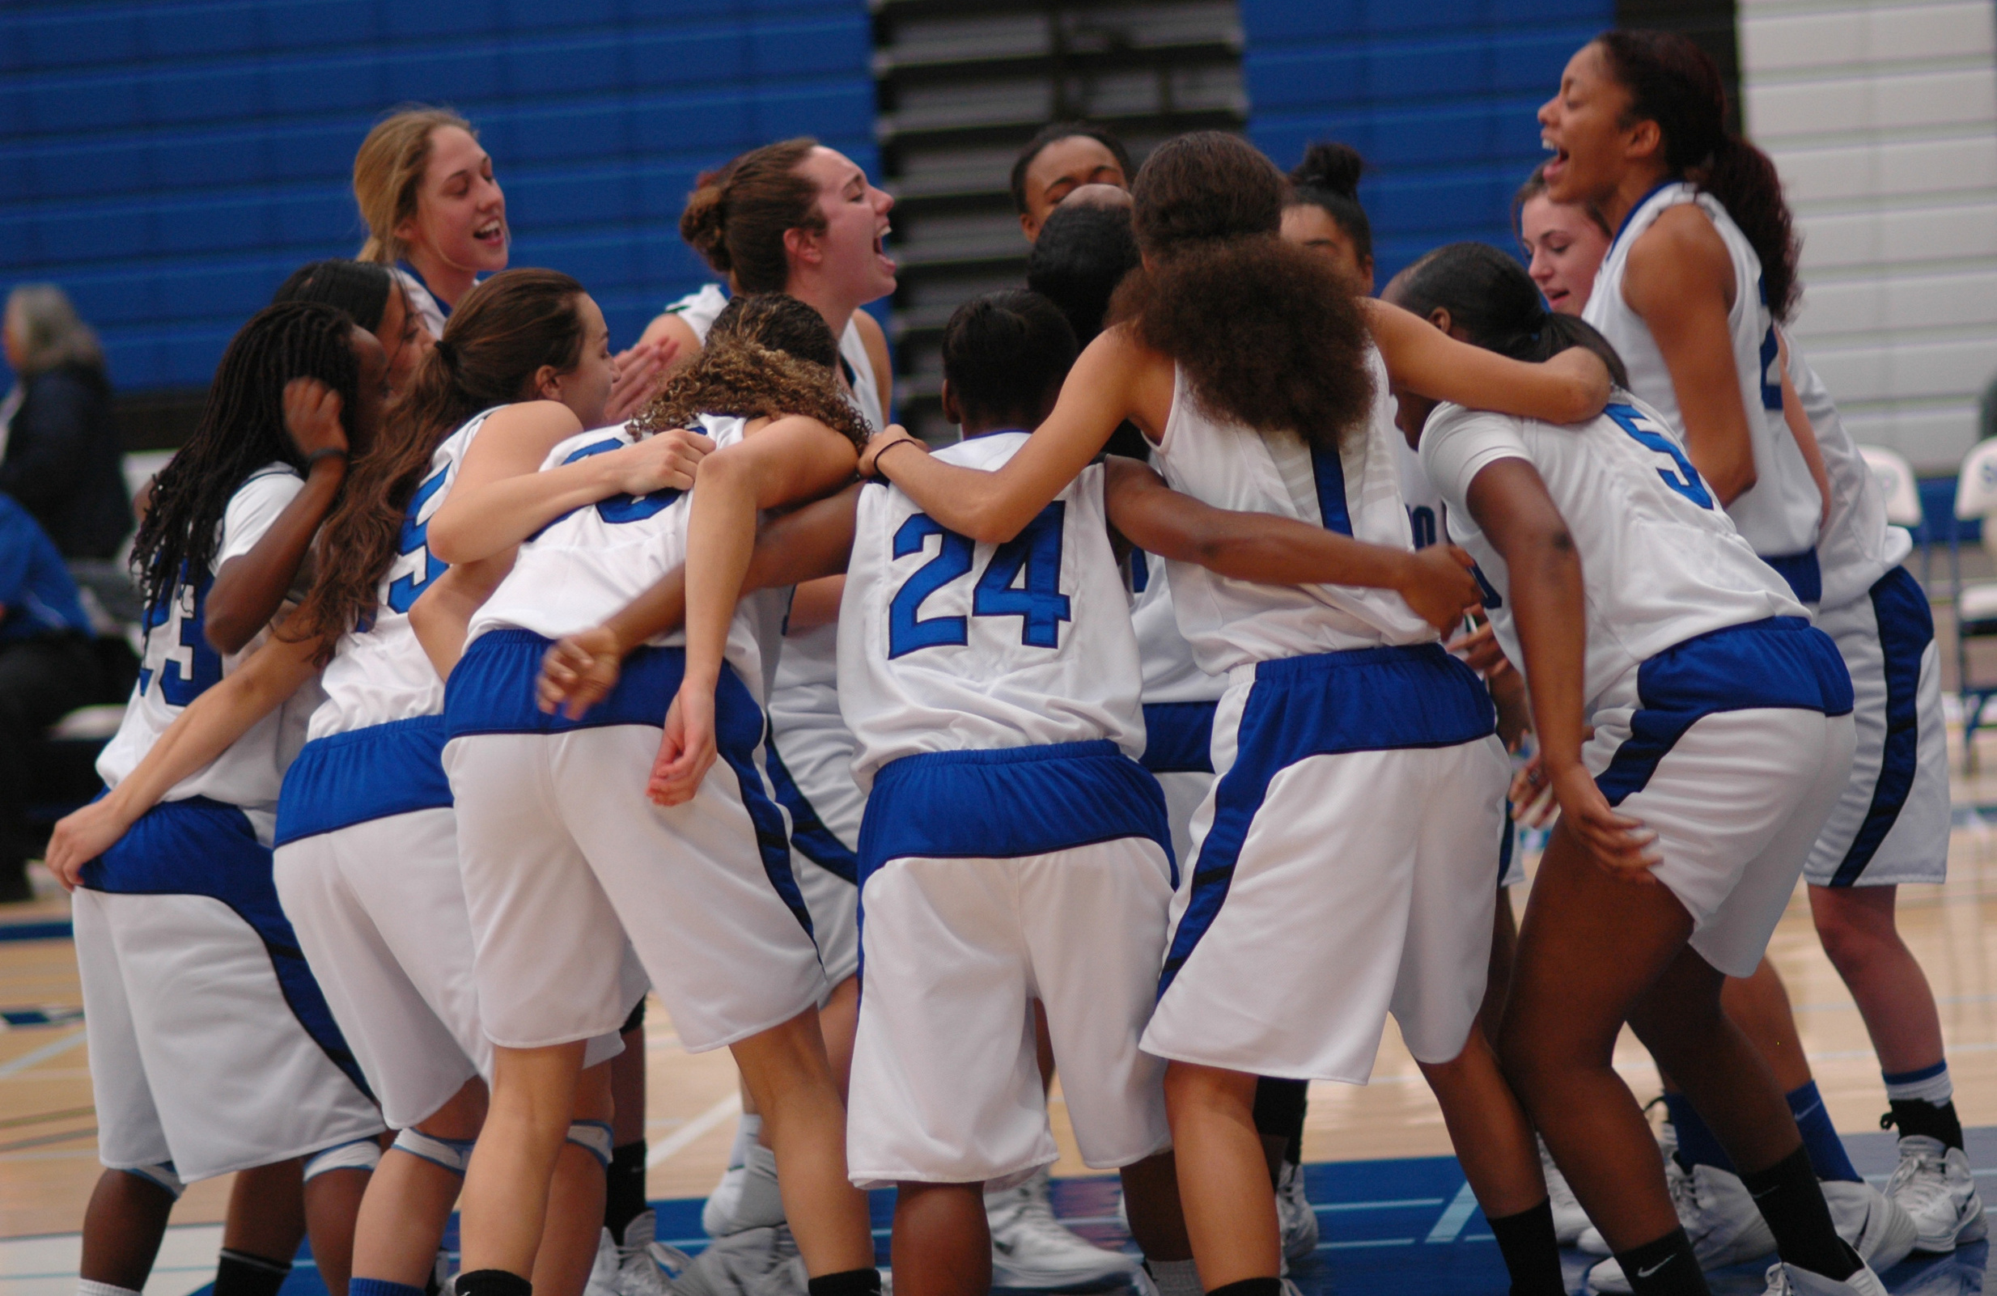
WOMEN’S BASKETBALL TEAM
2013 - 2014
Solano College Athletics
2026
TEAM SPECIAL RECOGNITION

Slide 17
Solano College Athletics
2026
TEAM SPECIAL RECOGNITION
WOMEN’S BASKETBALL TEAM
2013 - 2014
Records
26 - 5 overall
16 - 0 in BVC
Team Rankings/Achievements
#7 seed in State Playoffs
Made the Regional Semi-Finals
4th highest scoring team in the state
3rd in state for made field goals
2nd in state for steals per game
All-time program record of 80.1 ppg
All-time program record of most conference wins (16)
All-time program record of longest winning streak (18)
Player Achievements
3 All-State Players
5 All-Conference Players
4 Hall of Fame Inductees

Slide 18

CONGRATULATIONS
Solano College Athletics
2026
HALL OF FAME CLASS

